Slide 1

Decision Making and Brancing
Abu Saleh Musa Miah(Abid)
Research Student, Centre for Research & Innovation (CRI Unit-1)
Signal Processing & Computational Neuroscience Laboratory.
Dept. of Computer Science and Engineering (CSE).
University of Rajshahi.

Slide 2


Slide 3
Introduction
“Decision making and branching” is one of the most important concepts of computer programming.
Programs should be able to make logical (true/false) decisions based on the condition provided.
C language posseses such decision making capabilities by supporting the following statements :-
if statement
Switch statement
Conditional statement
Go to statement

Slide 4
Decision Making & Branching in C
These statements are knows as decision making statements. They are also called control statements as the control the flow of execution.

Slide 5
IF Statement
The if statement is a powerful decision making statement and is used to control the flow of execution of statements . it is basically a two-way decision statemenet and is used in conjunction with an expression.
It takes the following structure: if (test-condition)

Slide 6
IF Statement
Entry
Test Condition ?
False
True
Example:
If(Pocket balance is zero)
Borrow money;

Slide 7
IF Statement
The if statement can be implemented if four different forms depending on the complexity of the conditions to be tested. The four forms are:
Simple if statement
If else statement
Nested if else statement
Else if ladder

Slide 8
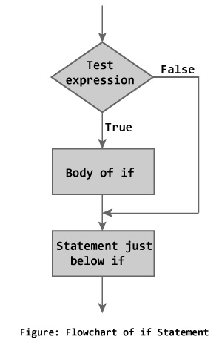
Simple if Statement- Structure
The general form of a simple if statement is:
if (test_condition)
{
statement-block;
}
statement x;

Slide 9
Simple if Statement- Flowchart
Entry
Test_Condition ?
[ True ]
Statement-block;
[ False ]
Statement-X;
Next Statement;

Slide 10
Simple if Statement
Int main()
{
Int a,b;
Printf(“Enter the value of a: ”);
Scanf(“%d”,&a);
Printf(“Enter the value of b: ”);
Scanf(“%d”,&b);
If(a>b)printf(“The bif number is =%d”,a);
}

Slide 11
Simple if Statement-Example
Example with block of statement:
if (marks>=40)
{ marks=marks+ bonus_marks;
grade=“Pass”;
}
printf(“The mark achieved:marks” , %d);
Condition controlled statement

Slide 12
if else Statement
If the test condition is true then the true block statements, immediately following the if statements are executed;
Otherwise the false block statements are executed.
In short either true-block or false-block of statements will be executed, not both.
But in both cases the control is transferred subsequently to the statement-x as it is an independent (not controlled by the if else statement) statement.
It is also called two way conditional branching

Slide 13
if else Statement- Structure
The if else statement is an extension of the simple if statement. The general form is :
if (test_condition)
{
True block statements;
}
else
{
False block statements;
}
statement-x;

Slide 14
if else Statement- Flowchart
Entry
[ False ]
Test_Condition ?
[ True ]
False Statement-block;
True Statement-block;
Statement-X;
Next Statement;

Slide 15
if else Statement- Example
Example with block of statement:
if (marks>=40)
{ marks=marks+ bonus_marks;
grade=“passed”;
}
else
{
marks=marks; grade=“failed”;
}
printf(“The mark achieved:marks” , %d);
True block statement
False block statement

Slide 16
Nested if else Statement
Using “if…else statement” within another “if…else statement” is called ‘nested if statement’. “Nested if statements” is mainly used to test multiple conditions.
It is called nested conditional branching.
They can be structured using following syntax:

Slide 17
Nested if else Statement- Structure
if (test_condition)
{
if (test_condition)
{
statement-block;
}
else
{
statement-block; }
}
else
{
statement-block;
}
statement-x;
Nested if else

Slide 18
Nested if else -Example
if (gender==female)
{
if (age<10)
{
provide free entry;
provide free food;
}
else
{
provide only free entry; }
}
else
{
statement-block;
}
statement-x;
Nested if else

Slide 19
Else if ladder Statement
The word ladder means the staircase. As the name implies this statement is used to choose right way/paths among multiple paths.
There is another way of putting if conditions together when multiway decisions are involved.
A multiway decision is a chain of if conditions in which the statement associated with an else condition behaves like another if condition.
Else if ladder is also called 3 way or multiway decision making statement.

Slide 20
Else if ladder- Structure
if (test_condition 1)
statement-1;
else if (test_condition 2)
statement-2;
else if (test_condition 3)
statement-3;
else if (test_condition 4)
statement-4;
…………………………………..
else if (test_condition n)
statement-n;
statement-x;

Slide 21
Else if ladder- Example
if(Mark>=50 && Mark<60)
{ printf("Your grade is D");
}
else if(Mark>=60 && Mark<70)
{ printf("Your grade is C n");
}
else if(Mark>=70 && Mark<80)
{ printf("Your grade is B n");
}
else if(Mark>=80 && Mark<90)
{ printf("Your grade is A n");
}
else
printf("you have failed");

Slide 22
Else if ladder- Example
If(a>b)
{
If(a>c)
Max=a;
Else
Max=b;
}
Else
{
If(b>c)
Max=b;
Else
Max=c
}
Printf(“Maximum =%d”,max);
}

Slide 23
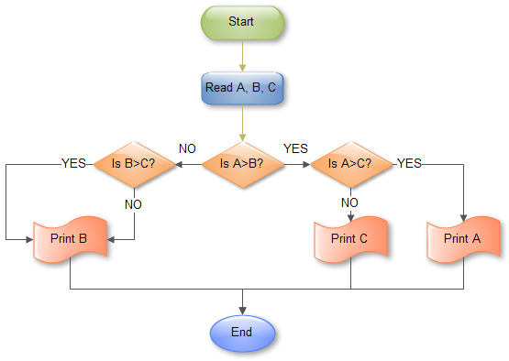
Else if ladder- Example

Slide 24
Switch CASE Statement
When one of the many statements is to be selected, then if conditional statement can be used to control the selection.
However the complexity of such a program increases dramatically when the number of statements increases.
Fortunately, C has a built in multiway decision making statement known as switch.
The switch statement tests the value of a given variable or expression against a list of case values and when a match is found only then a block of statements associated with that case is executed.
The general form is given below:

Slide 25
Switch Statement-Structure
switch(expression/ value)
{
case value-1:
statement-block-1;
break;
case value-2:
statement-block-2;
break;
……………………….
case value-n:
statement-block-n;
break;
default:
default-statement-block;
break;
}
statement-x;

Slide 26
Switch Statement-Structure
Int main(){
int month = 8;
String monthString;
switch (month) {
case 1: monthString = "January"; break;
case 2: monthString = "February"; break;
case 3: monthString = "March"; break;
case 4: monthString = "April"; break;
case 5: monthString = "May"; break;
case 6: monthString = "June"; break;
case 7: monthString = "July"; break;
case 8: monthString = "August"; break;
case 9: monthString = "September"; break;
case 10: monthString = "October"; break;
case 11: monthString = "November"; break;
case 12: monthString = "December"; break;
default: monthString = "Invalid month"; break; } System.out.println(monthString); }

Slide 27
#include<stdio.h>
int main()
{
int i=10,n=0;
while(i<1)
{
if(i&1==1)
{
i+i<<2;
i=i|1;
}
else i>>=1;
n++;
}
printf("%d",n);
return 0;
}

